Slide 1
Docker Certified Associate Training
Source: https://docs.docker.com
Source: https://success.docker.com
Notes:
Mention the course name

Slide 2
Networking
Notes:
Mention the topic name and convey its importance/role in brief

Slide 3

By the end of this lesson, you will be able to:
Explain different types of networks and their architecture
Describe the architecture of Container Network Model (CNM) and different network drivers
Explain various use cases for different types of networks
Identify and publish the ports
Access logs and troubleshoot services
Notes:
Explain the learning objectives

Slide 4
Network Architecture

Slide 5
Networks: Overview
Docker networking subsystem
use
Drivers
Types of drivers:
Bridge networks
Host networks
Overlay networks
Macvlan networks
Third-party network plugins
Notes:
Explain the content on slide using:
One of the reasons Docker containers and services are so powerful is that you can connect them together, or connect them to non-Docker workloads. Docker containers and services do not even need to be aware that they are deployed on Docker, or whether their peers are also Docker workloads or not.
Docker’s networking subsystem is pluggable, using drivers. Several drivers exist by default, and provide core networking functionality:
bridge: The default network driver. If you don’t specify a driver, this is the type of network you are creating. Bridge networks are usually used when your applications run in standalone containers that need to communicate.
host: For standalone containers, remove network isolation between the container and the Docker host, and use the host’s networking directly. host is only available for swarm services on Docker 17.06 and higher.
overlay: Overlay networks connect multiple Docker daemons together and enable swarm services to communicate with each other. You can also use overlay networks to facilitate communication between a swarm service and a standalone container, or between two standalone containers on different Docker daemons. This strategy removes the need to do OS-level routing between these containers.
macvlan: Macvlan networks allow you to assign a MAC address to a container, making it appear as a physical device on your network. The Docker daemon routes traffic to containers by their MAC addresses. Using the macvlan driver is sometimes the best choice when dealing with legacy applications that expect to be directly connected to the physical network, rather than routed through the Docker host’s network stack.
none: For this container, disable all networking. Usually used in conjunction with a custom network driver. none is not available for swarm services.
Network plugins: You can install and use third-party network plugins with Docker. These plugins are available from Docker Hub or from third-party vendors

Slide 6
Bridge Network
Notes:
Bridge networks

Slide 7
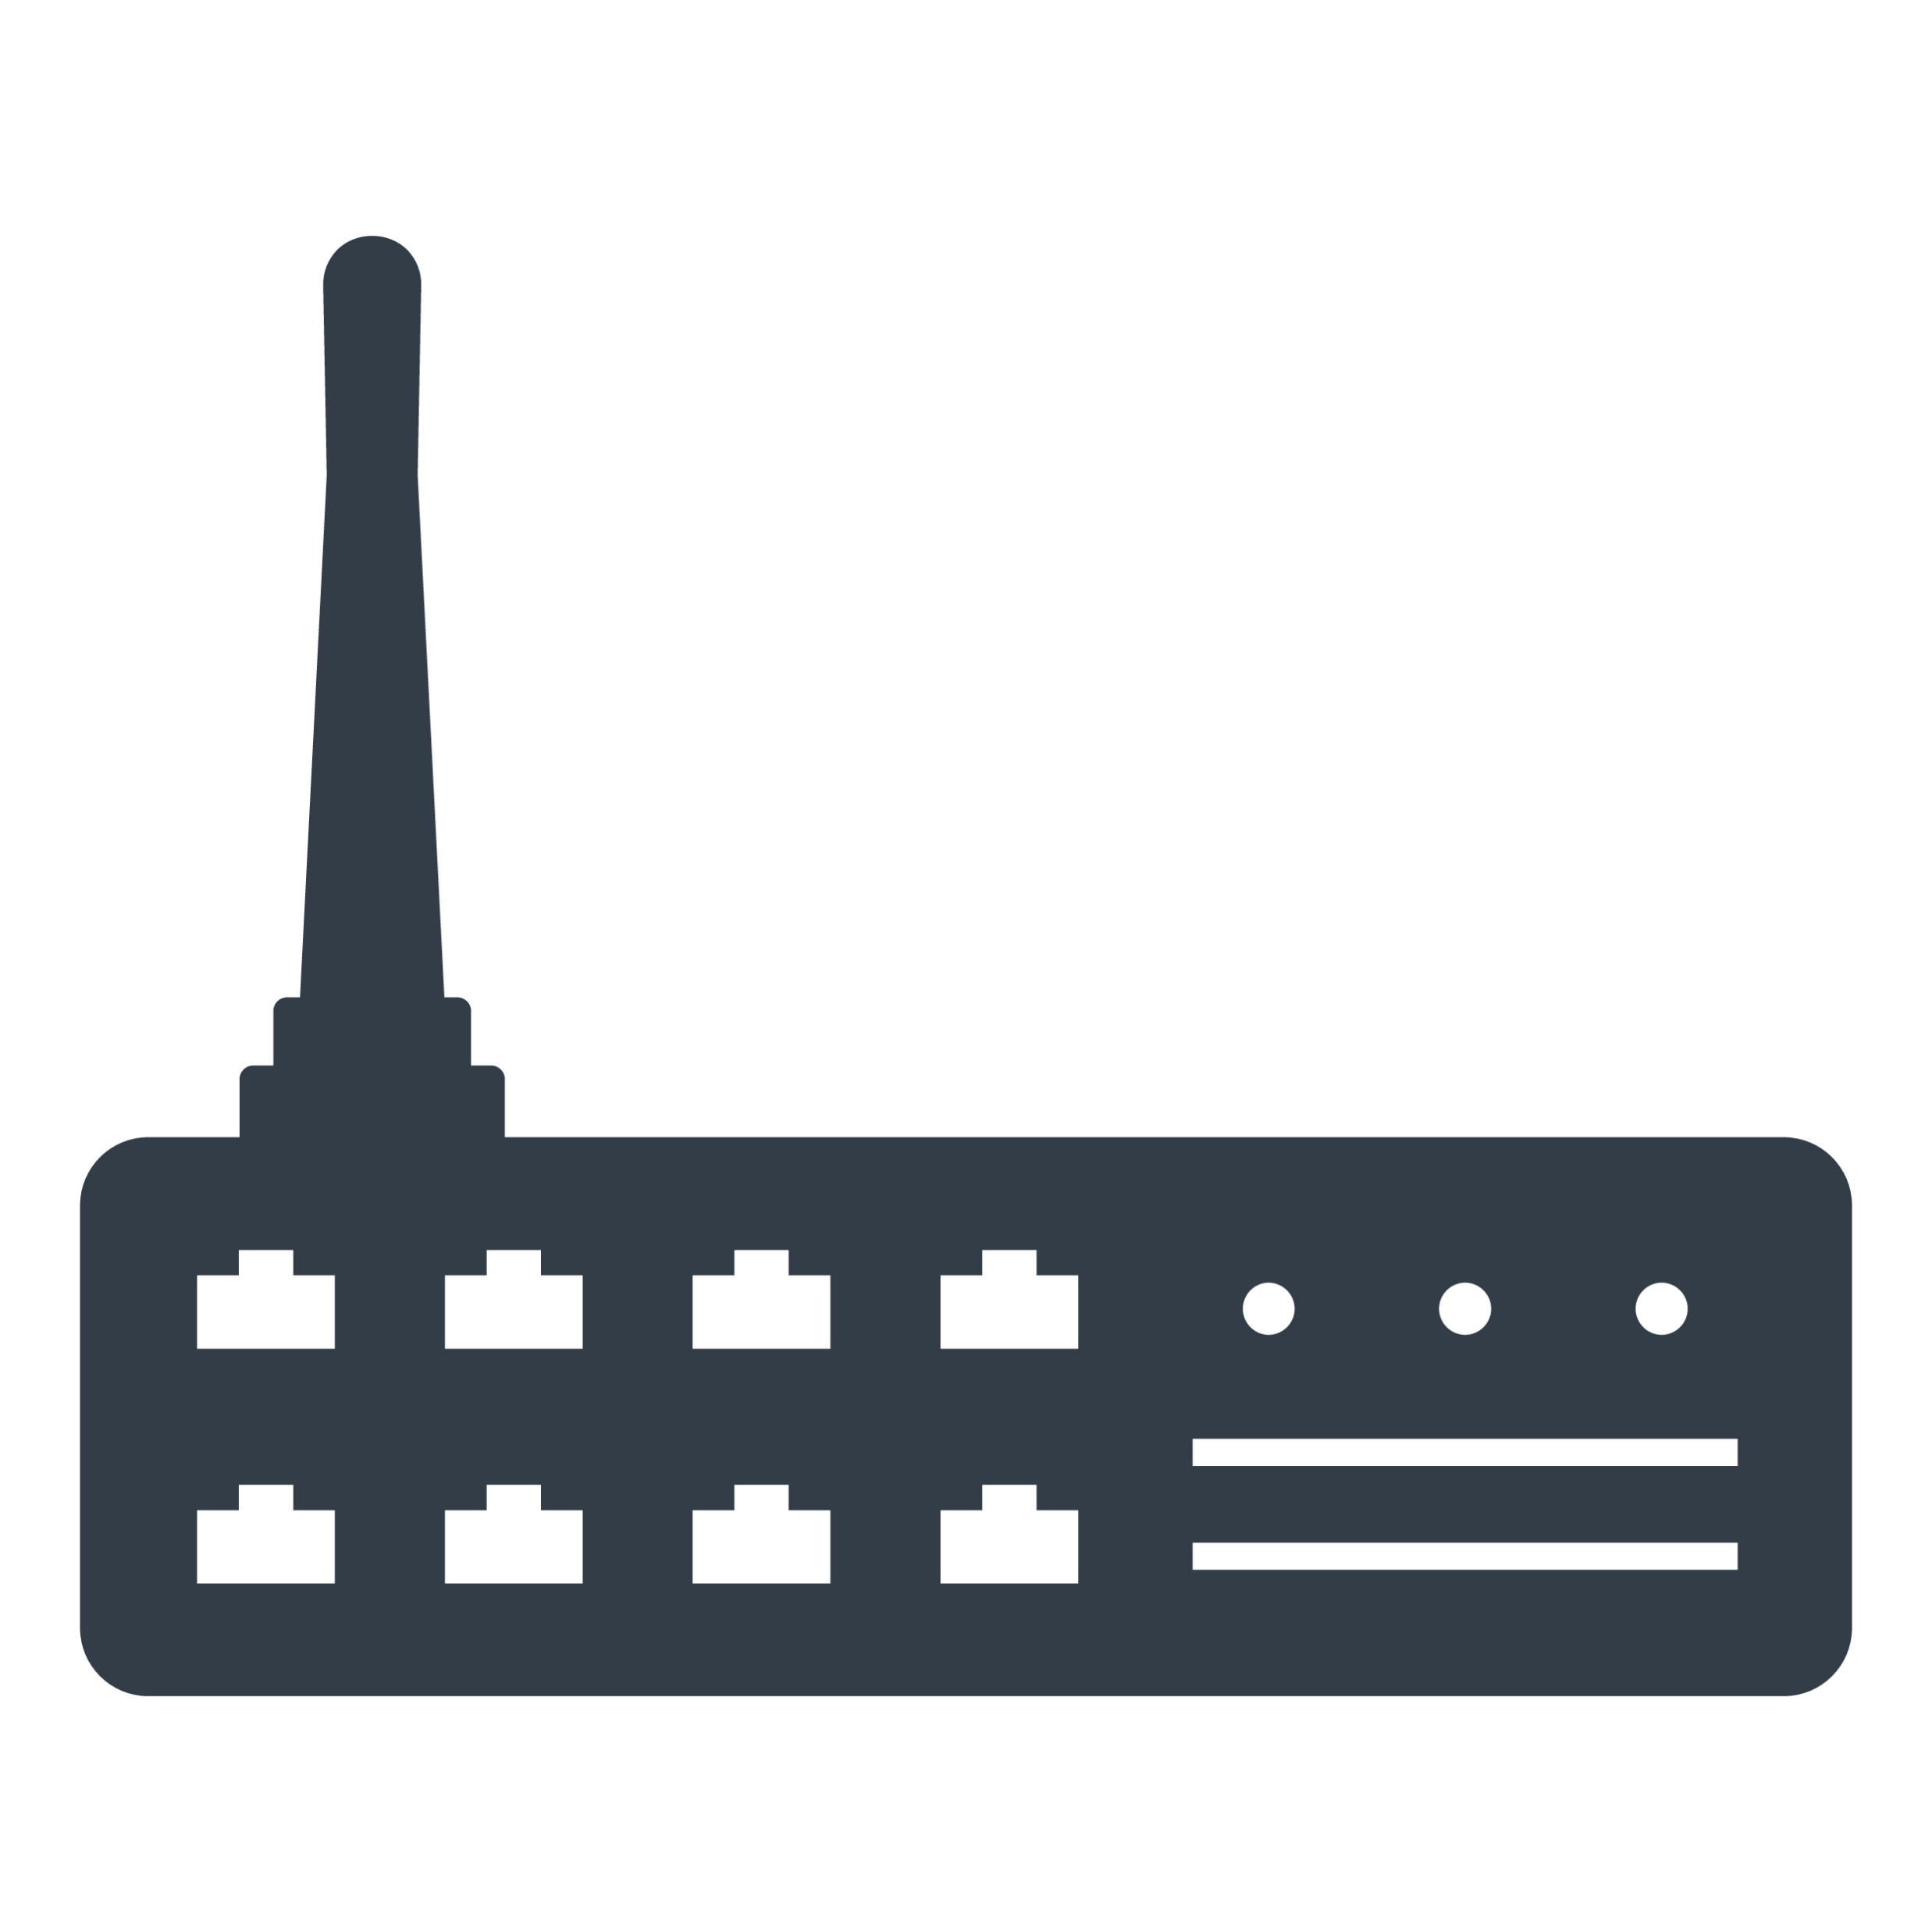

Bridge Network: Overview
Hardware device
Bridge network
Software device
Host
Container
Container
Container
Bridge
Source: https://success.docker.com/article/networking#dockerbridgenetworkdriver
Notes:
Explain the content on slide using:
A bridge can be a hardware device or a software device running within a host machine’s kernel.
Bridge networks apply to containers running on the same Docker daemon host.
When you start Docker, a default bridge network (also called bridge) is created automatically, and newly-started containers connect to it unless otherwise specified.
In terms of Docker, a bridge network uses a software bridge which allows containers connected to the same bridge network to communicate, while providing isolation from containers which are not connected to that bridge network. (colored dotted lines show different bridge network)
The Docker bridge driver automatically installs rules in the host machine so that containers on different bridge networks cannot communicate directly with each other.

Slide 8
Bridge Network
A Bridge is a default Docker network that is present on any Linux host which runs a Docker Engine.
creates
Bridge network driver
Bridge network
Understanding correlated terms:
A bridge is a Docker network
A bridge is also a Docker network driver/template, which creates a bridge network
docker0 is the kernel building block that is used in implementing the bridge network
Notes:
Explain bridge network
On any Linux host running Docker Engine, there is, by default, a local Docker network named bridge. This network is created using a bridge network driver which instantiates a Linux bridge called docker0. This may sound confusing.
bridge is the name of the Docker network
bridge is the Docker network driver, or template, from which this network is created
docker0 is the name of the Linux bridge that is the kernel building block used to implement this network

Slide 9
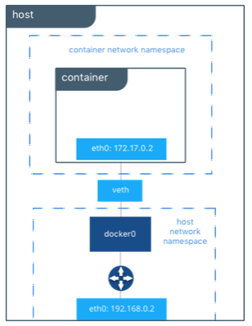
Bridge Network
The Docker Engine connects the container to the bridge network by default.
eth0 is created by the bridge driver and an address is given by the Docker native IPAM driver.
veth is a virtual ethernet interface which connects bridge to the eth0 interface inside the container.
docker0 is a Linux bridge that exists in the host network namespace.
The routing table connects docker0 and eth0 on the external network
Source: https://success.docker.com/article/networking#dockerbridgenetworkdriver
Notes:
Explain the diagram
On any Linux host running Docker Engine, there is, by default, a local Docker network named bridge. This network is created using a bridge network driver which instantiates a Linux bridge called docker0. This may sound confusing.
bridge is the name of the Docker network
bridge is the Docker network driver, or template, from which this network is created
docker0 is the name of the Linux bridge that is the kernel building block used to implement this network
Explain the diagram
In the following example a container is created with no network parameters. Docker Engine connects it to the bridge network by default. Inside the container, notice eth0 which is created by the bridge driver and given an address by the Docker native IPAM driver
The tool brctl on the host shows the Linux bridges that exist in the host network namespace. It shows a single bridge called docker0. docker0 has one interface, vetha3788c4, which provides connectivity from the bridge to the eth0 interface inside container c1.
The host routing table provides connectivity between docker0 and eth0 on the external network, completing the path from inside the container to the external network.

Slide 10
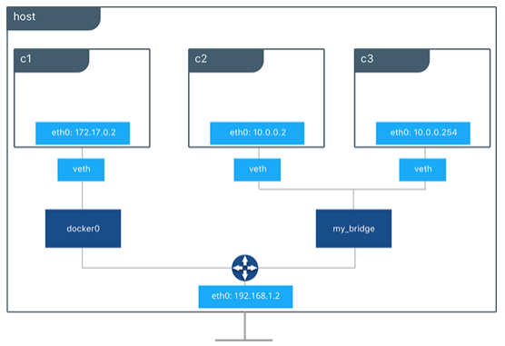
User-Defined Bridge Network
Containers
Virtual ethernet interfaces
A user-defined bridge that connects to two containers via two interfaces
The routing table connects docker0, my_bridge, and eth0 on the external network
Source: https://success.docker.com/article/networking#dockerbridgenetworkdriver
Notes:
Explain the diagram (explain architecture)

Slide 11
Bridge Network
Difference
Features | Default | User-defined
Better isolation and interoperability between containerized applications | No | Yes
Automatic DNS resolution between containers | No | Yes
Attachment and detachment of containers on the fly | No | Yes
Configurable bridge creation | No | Yes
Linked containers share environment variables | Yes | No
Notes:
Explain the features and their differences

Slide 12
Create a Bridge Network
Problem Statement: You are required to create a default network in docker and inspect it so that it can be established that the bridge driver is the default network driver.
Steps to Perform:
Create a default network.
List all the current networks to check whether a network is created or not.
Inspect the network created for the driver flag.

Slide 13
Create a User-Defined Bridge Network
Problem Statement: You have been asked to create a user-defined bridge network that can be used to connect multiple containers to a single network.
Steps to Perform:
Create a user-defined bridge network.
Create an nginx container and connect it to the user-defined bridge network.
Connect a running container to an existing network.
Disconnect the container from the network.

Slide 14
Host Network
Notes:
Mention the topic name and list the content that is going to be covered in the topic

Slide 15
Host Network: Overview
While using a host network, the container shares the host’s networking namespace, and the container is not allocated its own IP address.
Advantages:
Optimizes the performance
Handles a large range of ports
Does not require network address translation (NAT)
Does not require “userland-proxy” for each port
Notes:
Explain the content on slide using:
If you use the host network mode for a container, that container’s network stack is not isolated from the Docker host (the container shares the host’s networking namespace), and the container does not get its own IP-address allocated. For instance, if you run a container which binds to port 80 and you use host networking, the container’s application is available on port 80 on the host’s IP address.
Explain advantages of host network

Slide 16
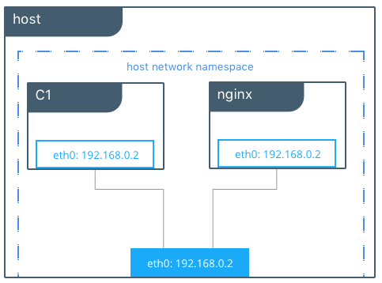
Host Network
These containers connect with each other using a localhost on C1.
The containers C1 and nginx are using the host network and share the same interface for eth0.
Source: https://success.docker.com/article/networking#dockerhostnetworkdriver
Notes:
Explain the architecture

Slide 17
Host Network
--network host: This is passed with command docker service create to use a host network for a swarm service.
Features:
An overlay network is used to manage swarm and service-related traffic.
The Docker daemon host network and ports are used to send data for individual swarm service.
Note: The host networking driver only works on Linux hosts.
Notes:
Explain the content on slide using:
You can also use a host network for a swarm service, by passing --network host to the docker service create command.
In this case, control traffic (traffic related to managing the swarm and the service) is still sent across an overlay network, but the individual swarm service containers send data using the Docker daemon’s host network and ports. This creates some extra limitations. For instance, if a service container binds to port 80, only one service container can run on a given swarm node.
The host networking driver only works on Linux hosts, and is not supported on Docker Desktop for Mac, Docker Desktop for Windows, or Docker EE for Windows Server.

Slide 18
Create a Host Network
Problem Statement: You have been asked to create a host network so that your container gets its own IP address allocation and is not isolated from the host.
Steps to Perform:
Create and start the container as a detached process.
Access Nginx by browsing to http://localhost:80/.
Examine all network interfaces and verify that a new one is not created.
Verify which process is bound to port 80 by using the netstat command.
Stop the container.

Slide 19
Overlay Network
Notes:
overlay network

Slide 20
Overlay Network: Overview
Overlay network driver: It creates a distributed network among multiple Docker daemon hosts.
Host 1
Host 2
Overlay
Notes:
Explain the content on slide using:
The overlay network driver creates a distributed network among multiple Docker daemon hosts.
This network sits on top of (overlays) the host-specific networks, allowing containers connected to it (including swarm service containers) to communicate securely. Docker transparently handles routing of each packet to and from the correct Docker daemon host and the correct destination container.

Slide 21
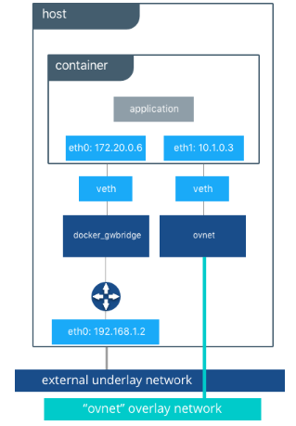
Overlay Network
Provisioning for an overlay network is automated by Docker Swarm control plane.
Virtual ethernet interfaces
An ovnet is a bridge with the overlay driver
A docker_gwbridge is an egress bridge
https://success.docker.com/article/networking#overlaydrivernetworkarchitecture
Notes:
Explain the architecture
Provisioning for an overlay network are automated by Docker Swarm control plane.
No VXLAN configuration or operating system networking configuration is required. Data-plane encryption, an optional feature of overlays on Linux, is also automatically configured by the overlay driver as networks are created. The user or network operator only has to define the network (docker network create -d overlay ...) and attach containers to that network.
When the overlay network is created, notice that several interfaces and bridges are created inside the host as well as two interfaces inside this container
On overlay networks, each container has at least two interfaces that connect it to the overlay and the docker_gwbridge respectively.

Slide 22
Overlay Network
Ingress
It handles data traffic and the controls related to swarm services.
Swarm
creates
docker_gwbridge
It connects all the Docker daemons which are participating in the swarm.
Notes:
Explain the content on slide using:
When you initialize a swarm or join a Docker host to an existing swarm, two new networks are created on that Docker host:
an overlay network called ingress, which handles control and data traffic related to swarm services. When you create a swarm service and do not connect it to a user-defined overlay network, it connects to the ingress network by default.
a bridge network called docker_gwbridge, which connects the individual Docker daemon to the other daemons participating in the swarm.

Slide 23
Overlay Network: Prerequisites
Open ports:
Open TCP port 2377 for cluster management communications
Open TCP and UDP port 7946 for communication among nodes
Open UDP port 4789 for overlay network traffic
Initialize Docker daemons:
Initialize Docker daemon as a swarm manager using docker swarm init, or join the Docker daemon to an existing swarm using docker swarm join, before creating an overlay network.
Notes:
Use the content below to explain the slide:
Prerequisites:
These ports must kept open to traffic to and from each Docker host participating on an overlay network:
TCP port 2377 for cluster management communications
TCP and UDP port 7946 for communication among nodes
UDP port 4789 for overlay network traffic
Before you can create an overlay network, you need to either initialize your Docker daemon as a swarm manager using docker swarm init or join it to an existing swarm using docker swarm join. Either of these creates the default ingress overlay network which is used by swarm services by default. You need to do this even if you never plan to use swarm services. Afterward, you can create additional user-defined overlay networks.

Slide 24
Macvlan Network
Notes:
Mention the topic name and list the content that is going to be covered in the topic

Slide 25
Macvlan Network: Overview
Macvlan network is used to assign MAC address to the virtual network interface of containers. This helps the legacy applications to directly connect to the physical network.
Precautionary measures:
Cut down the large number of unique MAC address to save the network from damage
Handle “promiscuous mode” via networking equipment to assign multiple MAC address to single physical interface
Notes:
Explain the content on slide using:
Some applications, especially legacy applications or applications which monitor network traffic, expect to be directly connected to the physical network. In this type of situation, you can use the macvlan network driver to assign a MAC address to each container’s virtual network interface.
Measures:
It is very easy to unintentionally damage your network due to IP address exhaustion or to “VLAN spread”, which is a situation in which you have an inappropriately large number of unique MAC addresses in your network.
Your networking equipment needs to be able to handle “promiscuous mode”, where one physical interface can be assigned multiple MAC addresses.

Slide 26
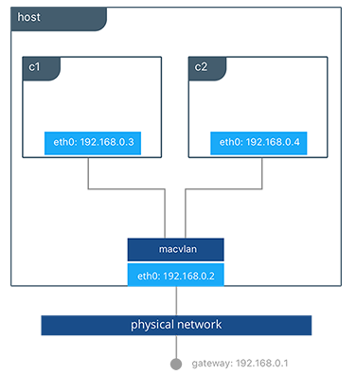
MACVLAN Network
Containers formed on mvnet network
An interface eth0 on the host is bound to mvnet (a MACVLAN network)
An external gateway is required during MACVLAN network configuration
https://success.docker.com/article/networking#macvlan
Notes:
Explain the architecture
ateway address is required during MACVLAN network configuration. The gateway must be external to the host provided by the network infrastructure

Slide 27
MACVLAN Network
Positive performance implications:
MACVLAN has simple and lightweight architecture
MACVLAN drivers provide direct access between physical network and containers
MACVLAN containers receive routable IP addresses that are present on the subnet of the physical network
Use cases of MACVLAN include:
Low-latency applications
Network design which needs containers to be on the same subnet and use IPs as the external host network
Notes:
Explain macvlan network
It has positive performance implications by virtue of having a very simple and lightweight architecture. Rather than port mapping, the MACVLAN driver provides direct access between containers and the physical network. It also allows containers to receive routable IP addresses that are on the subnet of the physical network.
MACVLAN use-cases may include:
Very low-latency applications
Network design that requires containers be on the same subnet as and using IPs as the external host network

Slide 28
Create a Macvlan Network
Problem Statement: Your manager has asked you to create a macvlan network for legacy applications so that it can be directly connected to a physical network.
Steps to Perform:
Create a Macvlan network in bridge mode along with parent name.
Exclude IP addresses from the macvlan network.
Create a Macvlan network in 802.1q trunk bridge mode.

Slide 29
None Network
Notes:
Mention the topic name and list the content that is going to be covered in the topic

Slide 30
None Network: Overview
None provides the functionality of disabling networking.
Form a container with none network:
Command:
$ docker run --rm -dit \
--network none \
--name no-net-alpine \
alpine:latest \
ash
Using this will result in a container with no eth0
Notes:
Explain the content on slide and use the following information as well:
With the network is none a container will not have access to any external routes. The container will still have a loopback interface enabled in the container but it does not have any routes to external traffic.

Slide 31
Prune Network

Slide 32
Prune Networks
Docker networks don’t take up much disk space, but they do create iptables rules, bridge network devices, and routing table entries.
The user can use the following command to clean up networks which aren’t used by any containers:
$ docker network prune
Notes:
Explain prune network

Slide 33
Container Networking Model

Slide 34
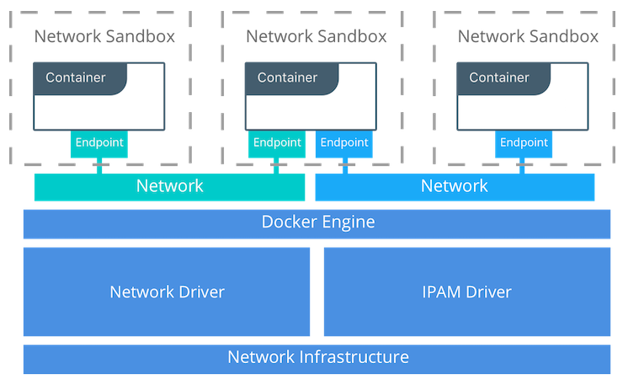
Container Networking Model (CNM)
The CNM provides portability to applications across diverse infrastructures.
A sandbox is composed of a container's network stack configuration.
These endpoints join the sandboxes to a network.
A Network is the collection of endpoints.
https://success.docker.com/article/networking#thecontainernetworkingmodel
Notes:
Explain the architecture.
High level constructs:
Sandbox — A Sandbox contains the configuration of a container's network stack. This includes the management of the container's interfaces, routing table, and DNS settings. An implementation of a Sandbox could be a Windows HNS or Linux Network Namespace, a FreeBSD Jail, or other similar concept. A Sandbox may contain many endpoints from multiple networks.
Endpoint — An Endpoint joins a Sandbox to a Network. The Endpoint construct exists so the actual connection to the network can be abstracted away from the application. This helps maintain portability so that a service can use different types of network drivers without being concerned with how it's connected to that network.
Network — The CNM does not specify a Network in terms of the OSI model. An implementation of a Network could be a Linux bridge, a VLAN, etc.. Endpoints that are not connected to a network do not have connectivity on a network.

Slide 35
Container Networking Model: Drivers
CNM drivers
Network drivers
IPAM drivers
Native network drivers
Remote network drivers
infoblox
Host
contiv
Bridge
weave
Overlay
kuryr
MACVLAN
None
Notes:
Explain function of each driver in brief.
None driver of Native network drivers:
The none driver gives a container its own networking stack and network namespace but does not configure interfaces inside the container. Without additional configuration, the container is completely isolated from the host networking stack.

Slide 36
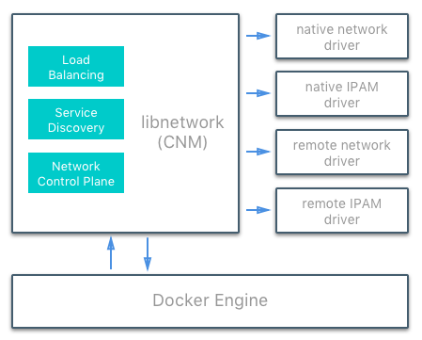
Interaction between Docker Engine, CNM, and Network Drivers
Source: https://success.docker.com/article/networking#thecontainernetworkingmodel
Notes:
Explain the how the docker engine, CNM, and network driver (including IPAM drivers) interact with each other.

Slide 37
Container Networking

Slide 38
Networking from Container Point of View
Routing table
Gateway
DNS services
Network interface components
IP address
Other networking details
Notes:
Explain the components of network interface
From the container’s point of view, it has a network interface with an IP address, a gateway, a routing table, DNS services, and other networking details (assuming the container is not using the none network driver).
Published ports:
By default, when you create a container, it does not publish any of its ports to the outside world. To make a port available to services outside of Docker, or to Docker containers which are not connected to the container’s network, use the --publish or -p flag. This creates a firewall rule which maps a container port to a port on the Docker host. Here are some examples.

Slide 39
Networking from Container Point of View
Published ports:
Making a port available using --publish or -p will create a firewall rule that map a container port to the port present on a Docker host. Examples are provided in the following table:
Flag value | Description
-p 8080:80 | TCP port 80 in the container is mapped to port 8080 on the Docker host.
-p 192.168.1.100:8080:80 | TCP port 80 in the container is mapped to port 8080 on the Docker host for connections to host IP 192.168.1.100.
-p 8080:80/udp | UDP port 80 in the container is mapped to port 8080 on the Docker host.
-p 8080:80/tcp -p 8080:80/udp | TCP port 80 in the container is mapped to TCP port 8080 on the Docker host and UDP port 80 in the container is mapped to UDP port 8080 on the Docker host.
Notes:
Explain published ports
From the container’s point of view, it has a network interface with an IP address, a gateway, a routing table, DNS services, and other networking details (assuming the container is not using the none network driver).
Published ports:
By default, when you create a container, it does not publish any of its ports to the outside world. To make a port available to services outside of Docker, or to Docker containers which are not connected to the container’s network, use the --publish or -p flag. This creates a firewall rule which maps a container port to a port on the Docker host. Here are some examples.

Slide 40
Networking from Container Point of View
IP address:
An IP address is assigned to a container for every Docker network that it connects to.
--network is used to connect a container to a single network.
The docker network connect is used to connect a running container to multiple networks.
The IP address can be specified while connecting the container to a network by using --ip or --ip6 flags.
Hostname:
Container ID in the Docker is the default hostname of the container.
A hostname is overridden by using --hostname.
Additional network alias is specified by using --alias flag for the container on an existing network.
Notes:
Explain IP address and hostname
By default, the container is assigned an IP address for every Docker network it connects to. The IP address is assigned from the pool assigned to the network, so the Docker daemon effectively acts as a DHCP server for each container. Each network also has a default subnet mask and gateway.
When the container starts, it can only be connected to a single network, using --network. However, you can connect a running container to multiple networks using docker network connect. When you start a container using the --network flag, you can specify the IP address assigned to the container on that network using the --ip or --ip6 flags.
When you connect an existing container to a different network using docker network connect, you can use the --ip or --ip6 flags on that command to specify the container’s IP address on the additional network.
In the same way, a container’s hostname defaults to be the container’s ID in Docker. You can override the hostname using --hostname. When connecting to an existing network using docker network connect, you can use the --alias flag to specify an additional network alias for the container on that network.

Slide 41
Networking from Container Point of View
DNS services:
A container inherits the DNS settings of the Docker daemon, including the /etc/hosts and /etc/resolv.conf.
Flag | Description
--dns | IP address of a DNS server. Multiple --dns flags are used to specify multiple DNS servers.
--dns-search | Searches non-fully-qualified hostnames. Multiple --dns-search flags are used to specify multiple DNS search prefixes.
--dns-opt | Represents a DNS option and its value.
--hostname | Hostname of a container.
Notes:
Explain DNS Services
--dns: The IP address of a DNS server. To specify multiple DNS servers, use multiple --dns flags. If the container cannot reach any of the IP addresses you specify, Google’s public DNS server 8.8.8.8 is added, so that your container can resolve internet domains.
--dns-search: A DNS search domain to search non-fully-qualified hostnames. To specify multiple DNS search prefixes, use multiple --dns-search flags.
--dns-opt: A key-value pair representing a DNS option and its value. See your operating system’s documentation for resolv.conf for valid options.
--hostname: The hostname a container uses for itself. Defaults to the container’s ID if not specified.

Slide 42
Use Cases of Network Drivers

Slide 43
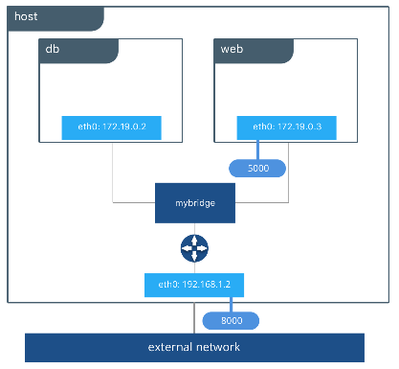
Bridge Network Driver: Use Case
db and web are containers of an application called pets. This application is available on <host-ip>:8000.
mybridge is helping containers web to interact with db by its container name. This driver is a local scope driver.
An application pets is served on the host at port 8000.
Note: The discovery of service is done automatically by the Docker bridge because they are on the same network.
Source: https://www.docker.com/blog/understanding-docker-networking-drivers-use-cases/
Notes:
Explain the diagram of bridge network driver
In the following examples, we use a fictitious app called pets comprised of a web and db container. Feel free to try it out on your own UCP or Swarm cluster. Your app will be accessible on `<host-ip>:8000`.
Command:
docker network create -d bridge mybridge docker run -d --net mybridge --name db redis docker run -d --net mybridge -e DB=db -p 8000:5000 --name web chrch/web
Our application is now being served on our host at port 8000. The Docker bridge is allowing web to communicate with db by its container name. All of the port mappings, security rules, and pipework between Linux bridges is handled for us by the networking driver as containers are scheduled and rescheduled across a cluster.
The bridge driver is a local scope driver, which means it only provides service discovery, IPAM, and connectivity on a single host. Multi-host service discovery requires an external solution that can map containers to their host location. This is exactly what makes the overlay driver so great.
Note:
bridge driver does the service discovery for us automatically because they are on the same network.

Slide 44
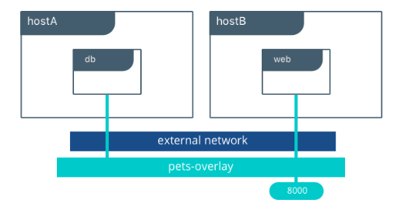
Overlay Network Driver: Use Case
The application pets is deployed on db and web. These two containers are present on different hosts.
The overlay network, which is created by a Universal Control Panel, allows the db and web to connect to each other.
Source: https://www.docker.com/blog/understanding-docker-networking-drivers-use-cases/
Notes:
Explain the diagram of overlay network driver
The overlay driver utilizes an industry-standard VXLAN data plane that decouples the container network from the underlying physical network (the underlay). This has the advantage of providing maximum portability across various cloud and on-premises networks. Network policy, visibility, and security is controlled centrally through the Docker Universal Control Plane (UCP).
We are using the same app “pets” which is available on <host-ip>:8000
In this example we create an overlay network in UCP so we can connect our web and db containers when they are living on different hosts. Native DNS-based service discovery for services & containers within an overlay network will ensure that web can resolve to db and vice-versa. We turned on encryption so that communication between our containers is secure by default. Furthermore, visibility and use of the network in UCP is restricted by the permissions label we use.
UCP will schedule services across the cluster and UCP will dynamically program the overlay network to provide connectivity to the containers wherever they are. When services are backed by multiple containers, VIP-based load balancing will distribute traffic across all of the containers.
Command:
docker network create -d overlay --opt encrypted pets-overlay docker service create --network pets-overlay
In this example we are still serving our web app on port 8000 but now we have deployed our application across different hosts. If we wanted to scale our web containers, Swarm & UCP networking would load balance the traffic for us automatically.
The overlay driver is a feature-rich driver that handles much of the complexity and integration that organizations struggle with when crafting piecemeal solutions. It provides an out-of-the-box solution for many networking challenges and does so at scale.

Slide 45
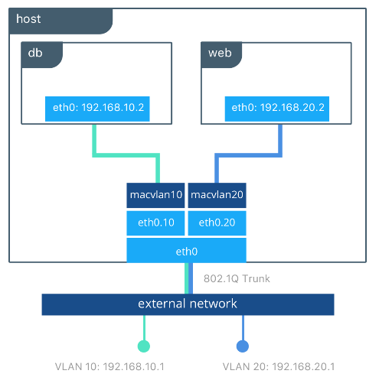
MACVLAN Network Driver: Use Case
db and web are present on the same host and connected to different MACVLAN networks.
Two MACVLAN networks are created and joined to different sub-interfaces.
The external networks are specific for specific containers.
Source: https://www.docker.com/blog/understanding-docker-networking-drivers-use-cases/
Notes:
Explain the diagram of macvlan network driver
The macvlan driver can be configured in different ways to achieve different results. In the below example we create two MACVLAN networks joined to different subinterfaces. This type of configuration can be used to extend multiple L2 VLANs through the host interface directly to containers. The VLAN default gateway exists in the external network.
The db and web containers are connected to different MACVLAN networks in this example. Each container resides on its respective external network with an external IP provided from that network. Using this design an operator can control network policy outside of the host and segment containers at L2. The containers could have also been placed in the same VLAN by configuring them on the same MACVLAN network. This just shows the amount of flexibility offered by each network driver.

Slide 46
Create an Overlay Network
Problem Statement: Your colleague wants you to create an overlay network so that it can be used by individual container or swarm services in order to communicate with each other.
Steps to Perform:
Initialize Docker daemon as a swarm manager.
Create an overlay network with both --opt encrypted and --attachable flag to attach unmanaged containers to that network.
Remove the existing ingress network and create a new overlay network using the --ingress flag. Set the MTU to 1200, the subnet to 10.11.0.0/16, and the gateway to 10.11.0.2.
Notes:
Moved to Orchestration

Slide 47
Deploy a Service on an Overlay Network
Problem Statement: Your manager asks you to deploy a service on an overlay network that can be used by different containers in the network.
Steps to Perform:
Attach a service to an existing overlay network.
List the networks connected to the service.
Inspect the network to check which containers and services are attached.
Notes:
Moved to Orchestration

Slide 48
Ports

Slide 49
Identifying Ports
Role of port:
The host port is bound to the container’s port allowing the container to connect to the external environment.
Use docker ps to find all the ports mapped:
Command:
$ docker ps
Output:
CONTAINER ID IMAGE COMMAND CREATED STATUS PORTS
b650456536c7 busybox:latest top About an hour ago Up About an hour 0.0.0.0:1234->9876/tcp, 0.0.0.0:4321->7890/tcp
NAMES
test
Host port
Container port
Notes:
Explain the use of port and explain the example quoted above (show it on docker)

Slide 50
Publishing and Exposing Ports

Slide 51
Publishing Ports
Ways to publish swarm service port to hosts that are present outside the swarm:
Using the routing mesh
Bypassing the routing mesh
Using the routing mesh:
Use --publish <PUBLISHED-PORT>:<SERVICE-PORT> flag in order to publish a service’s ports externally to the swarm.
Example:
$ docker service create --name my_web \
--replicas 3 \
--publish published=8080,target=80 \
nginx
Notes:
Explain the publishing ports
When you create a swarm service, you can publish that service’s ports to hosts outside the swarm in two ways:
You can rely on the routing mesh. When you publish a service port, the swarm makes the service accessible at the target port on every node, regardless of whether there is a task for the service running on that node or not. This is less complex and is the right choice for many types of services.
You can publish a service task’s port directly on the swarm node where that service is running. This feature is available in Docker 1.13 and higher. This bypasses the routing mesh and provides the maximum flexibility, including the ability for you to develop your own routing framework. However, you are responsible for keeping track of where each task is running and routing requests to the tasks, and load-balancing across the nodes.
Publish a service’s ports using the routing mesh
To publish a service’s ports externally to the swarm, use the --publish <PUBLISHED-PORT>:<SERVICE-PORT> flag
The external host does not need to know the IP addresses or internally-used ports of the service tasks to interact with the service. When a user or process connects to a service, any worker node running a service task may respond.
Example: Run a three-task Nginx service on 10-node swarm
Imagine that you have a 10-node swarm, and you deploy an Nginx service running three tasks on a 10-node swarm:
$ docker service create --name my_web \ --replicas 3 \ --publish published=8080,target=80 \ nginx
Three tasks run on up to three nodes. You don’t need to know which nodes are running the tasks; connecting to port 8080 on any of the 10 nodes connects you to one of the three nginx tasks. You can test this using curl. The following example assumes that localhost is one of the swarm nodes. If this is not the case, or localhost does not resolve to an IP address on your host, substitute the host’s IP address or resolvable host name.
The HTML output is truncated:
$ curl localhost:8080 <!DOCTYPE html> <html> <head> <title>Welcome to nginx!</title> ...truncated... </html>

Slide 52
Publishing Ports
Bypassing the routing mesh:
Use the mode=host option to the --publish flag in order to publish a service’s port directly on the node where it is running.
Example:
$ docker service create \
--mode global \
--publish mode=host,target=80,published=8080 \
--name=nginx \
nginx:latest
Notes:
Explain publishing ports
Publish a service’s ports directly on the swarm node
The following example runs nginx as a service on each node in your swarm and exposes nginx port locally on each swarm node.
$ docker service create \ --mode global \ --publish mode=host,target=80,published=8080 \ --name=nginx \ nginx:latest
You can reach the nginx server on port 8080 of every swarm node. If you add a node to the swarm, a nginx task is started on it. You cannot start another service or container on any swarm node which binds to port 8080.

Slide 53
Exposing Ports
Exposing ports:
Using --expose exposes the ports or range of ports in the container.
Example: Let us expose port 80 without publishing the port
$ docker run --expose 80 ubuntu bash
Notes:
Explain publishing ports
Publish a service’s ports directly on the swarm node
The following example runs nginx as a service on each node in your swarm and exposes nginx port locally on each swarm node.
$ docker service create \ --mode global \ --publish mode=host,target=80,published=8080 \ --name=nginx \ nginx:latest
You can reach the nginx server on port 8080 of every swarm node. If you add a node to the swarm, a nginx task is started on it. You cannot start another service or container on any swarm node which binds to port 8080.

Slide 54
Publishing Ports
Problem Statement: You are required to publish a swarm service’s port to external hosts in different ways so that it can be accessed externally.
Steps to Perform:
Publishing a swarm service’s port using the routing mesh.
Check whether your service has started on published port or not.
Publishing a swarm service’s port directly on the swarm node.

Slide 55
Traffic

Slide 56
Traffic
Inbound Traffic for Swarm Management:
Swarm mode port | Purpose
TCP port 2377 | Cluster management and raft sync communications
TCP and UDP port 7946 | Communication between all nodes
UDP port 4789 | Overlay network traffic
While using overlay network with the encryption option, ensure that the IP protocol 50 (ESP) traffic is allowed.
Notes:
Explain traffic
Inbound Traffic for Swarm Management
TCP port 2377 -> for cluster management & raft sync communications
TCP and UDP port 7946 -> for "control plane" gossip discovery communication between all nodes
UDP port 4789 -> for "data plane" VXLAN overlay network traffic
IP Protocol 50 (ESP) –> while using overlay network with the encryption option
The list below shows the network ports and protocols that the different components of a Swam cluster listen on.

Slide 57
Traffic
Network ports and protocols that Swarm cluster components listen on:
Cluster components | Port and protocols | Purpose
Swarm manager | Inbound 80/tcp (HTTP) | Allows docker pull commands to work
 | Inbound 2375/tcp | Allows Docker Engine CLI commands to the Engine daemon
 | Inbound 3375/tcp | Allows Engine CLI commands to the swarm manager
 | Inbound 22/tcp | Allows remote management through SSH
Service discovery | Inbound 80/tcp (HTTP) | Allows docker pull commands to work
 | Inbound Discovery service port | Requires setting to the port that the backend discovery service listens on
 | Inbound 22/tcp | Allows remote management through SSH
Notes:
Explain traffic
The list below shows the network ports and protocols that the different components of a Swam cluster listen on.
Swarm manager.
Inbound 80/tcp (HTTP). This allows docker pull commands to work. If you plan to pull images from Docker Hub, you must allow Internet connections through port 80.
Inbound 2375/tcp. This allows Docker Engine CLI commands direct to the Engine daemon.
Inbound 3375/tcp. This allows Engine CLI commands to the swarm manager.
Inbound 22/tcp. This allows remote management via SSH.
Service Discovery:
Inbound 80/tcp (HTTP). This allows docker pull commands to work. If you plan to pull images from Docker Hub, you must allow Internet connections through port 80.
Inbound Discovery service port. This needs setting to the port that the backend discovery service listens on (consul, etcd, or zookeeper).
Inbound 22/tcp. This allows remote management via SSH.

Slide 58
Traffic
Network ports and protocols that Swarm cluster components listen on:
Cluster components | Port and protocols | Purpose
Swarm nodes | Inbound 80/tcp (HTTP) | Allows docker pull commands to work
 | Inbound 2375/tcp | Allows Engine CLI commands to the Docker daemon
 | Inbound 22/tcp | Allows remote management through SSH
Custom, cross-host container networks | Inbound 7946/tcp | Allows discovery of other container networks
 | Inbound 7946/udp | Allows discovery of container networks
 | Inbound <store-port>/tcp | It is a network key-value store service port
 | 4789/udp | Required for the container overlay network
 | ESP packets | Required for encrypted overlay networks
Notes:
Explain the cluster components of traffic
The list below shows the network ports and protocols that the different components of a Swam cluster listen on.
Swarm nodes:
Inbound 80/tcp (HTTP). This allows docker pull commands to work. If you plan to pull images from Docker Hub, you must allow Internet connections through port 80.
Inbound 2375/tcp. This allows Engine CLI commands direct to the Docker daemon.
Inbound 22/tcp. This allows remote management via SSH.
Custom, cross-host container networks:
Inbound 7946/tcp Allows for discovering other container networks.
Inbound 7946/udp Allows for discovering other container networks.
Inbound <store-port>/tcp Network key-value store service port.
4789/udp For the container overlay network.
ESP packets For encrypted overlay networks.

Slide 59
Configure Docker to Use External DNS
Problem Statement: You have been asked to configure your Docker daemon to use external DNS so that it can be used to pull images from an external IP address.
Steps to Perform:
Navigate to Docker Daemon config file daemon.json.
In daemon.json file, add the dns key with one or more IP addresses.
Restart the Docker Daemon.
Pull an image from external DNS to check if docker can use external IP address.

Slide 60
Docker Link

Slide 61
Docker Link
Docker containers have other means apart from using the network port mapping to connect to one another. Docker containers also communicate using the linking system. Information can be sent to a recipient container from a source container, when the containers are linked.
Docker link feature allows the containers to:
Discover each other
Transfer information between containers in secure manner.
Notes:
Explain Docker link and its features
Before moving to legacy networking, first we need to understand the docker container networking (which we have covered earlier in this lesson)
Network port mappings are not the only way Docker containers can connect to one another.
Docker link feature to allow containers to discover each other and securely transfer information about one container to another container. With the introduction of the Docker networks feature, you can still create links, but they behave differently between default bridge network and user defined networks.
When containers are linked, information about a source container can be sent to a recipient container. This allows the recipient to see selected data describing aspects of the source container.

Slide 62
Docker Link
Every container that is created will automatically get a name. The name of a container provides two functions:
Describes the function of the container
Provides a reference point to Docker
Name the container using --name flag:
$ docker run -d -P --name asper training/webapp python app.py
Find the name of the container:
$ docker ps -l
Notes:
Explain the functions of Docker link
The importance of naming
To establish links, Docker relies on the names of your containers. You’ve already seen that each container you create has an automatically created name. You can also name containers yourself.
This naming provides two useful functions:
It can be useful to name containers that do specific functions in a way that makes it easier for you to remember them, for example naming a container containing a web application asper.
It provides Docker with a reference point that allows it to refer to other containers, for example, you can specify to link the container web to container db.
You can name your container by using the --name flag, for example:
$ docker run -d -P --name asper training/webapp python app.py
Explain what does the code do: This launches a new container and uses the --name flag to name the container asper.
You can see the container’s name using the docker ps command:
$ docker ps -l
Explain Output:
CONTAINER ID IMAGE COMMAND CREATED STATUS PORTS NAMES
aed84ee21bde training/webapp:latest python app.py 12 hours ago Up 2 seconds 0.0.0.0:49154->5000/tcp asper

Slide 63
Communication across Links
Create a new container named db containing a database:
$ docker run -d --name db training/postgres
Create a new web container and link it with db container:
$ docker run -d -P --name web --link db:db training/webapp python app.py
Inspect the linked containers:
$ docker inspect -f "{{ .HostConfig.Links }}" web
Notes:
Explain the steps and also tell learners that how 2 containers can be linked:
create a new container, this time one containing a database
Create a new web container and link it with your db container. (before creating new web delete the previous web, using $ docker container rm -f web). This links the new web container with the db container you created earlier. The --link flag takes the form: --link <name or id>:alias
Next, inspect your linked containers with docker inspect:
$ docker inspect -f "{{ .HostConfig.Links }}" web
[/db:/web/db]
web is now connected to db container web/db

Slide 64
Communication across Links
How web accesses information from the source db:
web
db
tunnel
Ports
Ports
Ways to expose connectivity information between containers by:
Using Environment variables
Updating the /etc/hosts file
Notes:
Explain communication across links
In our example, the recipient, web, can access information about the source db. To do this, Docker creates a secure tunnel between the containers that doesn’t need to expose any ports externally on the container; when we started the db container we did not use either the -P or -p flags. That’s a big benefit of linking: we don’t need to expose the source container, here the PostgreSQL database, to the network.
Docker exposes connectivity information for the source container to the recipient container in two ways:
Environment variables,
Updating the /etc/hosts file.

Slide 65
A Sandbox contains the configuration of a container's network stack.
A Network is a collection of endpoints. These endpoints join the Sandbox to the Network.
A container is given its own networking stack and a network namespace by a none driver, but this driver does not configure interfaces inside the container.
On creation of a container, the interaction with the outside world is not possible, because the ports are not automatically published.
Notes:
Read the points in key takeaways

Slide 67
Which of the following are native network drivers? (Select all that apply.)
1
Host Network
Overlay Network
Macvlan Network
Weave Network

Slide 68
Which of the following are native network drivers? (Select all that apply.)
1
Host Network
Overlay Network
Macvlan Network
Weave Network
a, b, and c.
The native network drivers are Host Network, Overlay Network, and Macvlan Network.

Slide 69
Which network is automated by Docker Swarm control plane?
2
Host Network
Overlay Network
Macvlan Network
Weave Network

Slide 70
Which network is automated by Docker Swarm control plane?
1
Host Network
Overlay Network
Macvlan Network
Weave Network
b.
Overlay network is automated by Docker Swarm control plane.

Slide 71
Which command shows information logged by a running container?
3
Docker service logs
Access logs
Docker logs
Container logs

Slide 72
Which command shows information logged by a running container?
3
Docker service logs
Access logs
Docker logs
Container logs
c.
The command docker logs shows information logged by a running container.

Slide 73
________ is composed of the configuration of a container's network stack.
4
Sandbox
Published port
Docker host
DNS services

Slide 74
________ is composed of the configuration of a container's network stack.
4
Sandbox
Published port
Docker host
DNS services
a.
A sandbox is composed of the configuration of a container's network stack.

